Slide 1
HAZOP-UML overview

Slide 2
HAZard OPerability (HAZOP)
Main principle
  System parameter (ex. temperature)
  Guide-word from a generic list
    (ex: more, less, etc…)
  Deviation identification
  Consequences analysis and recommendations
Exemple
  Temperature x More = temperature too high
How to identify these parameters and associated deviations ?
Notes:
----- Notes de la réunion (16/03/15 11:51) -----
- enlever study

Slide 3
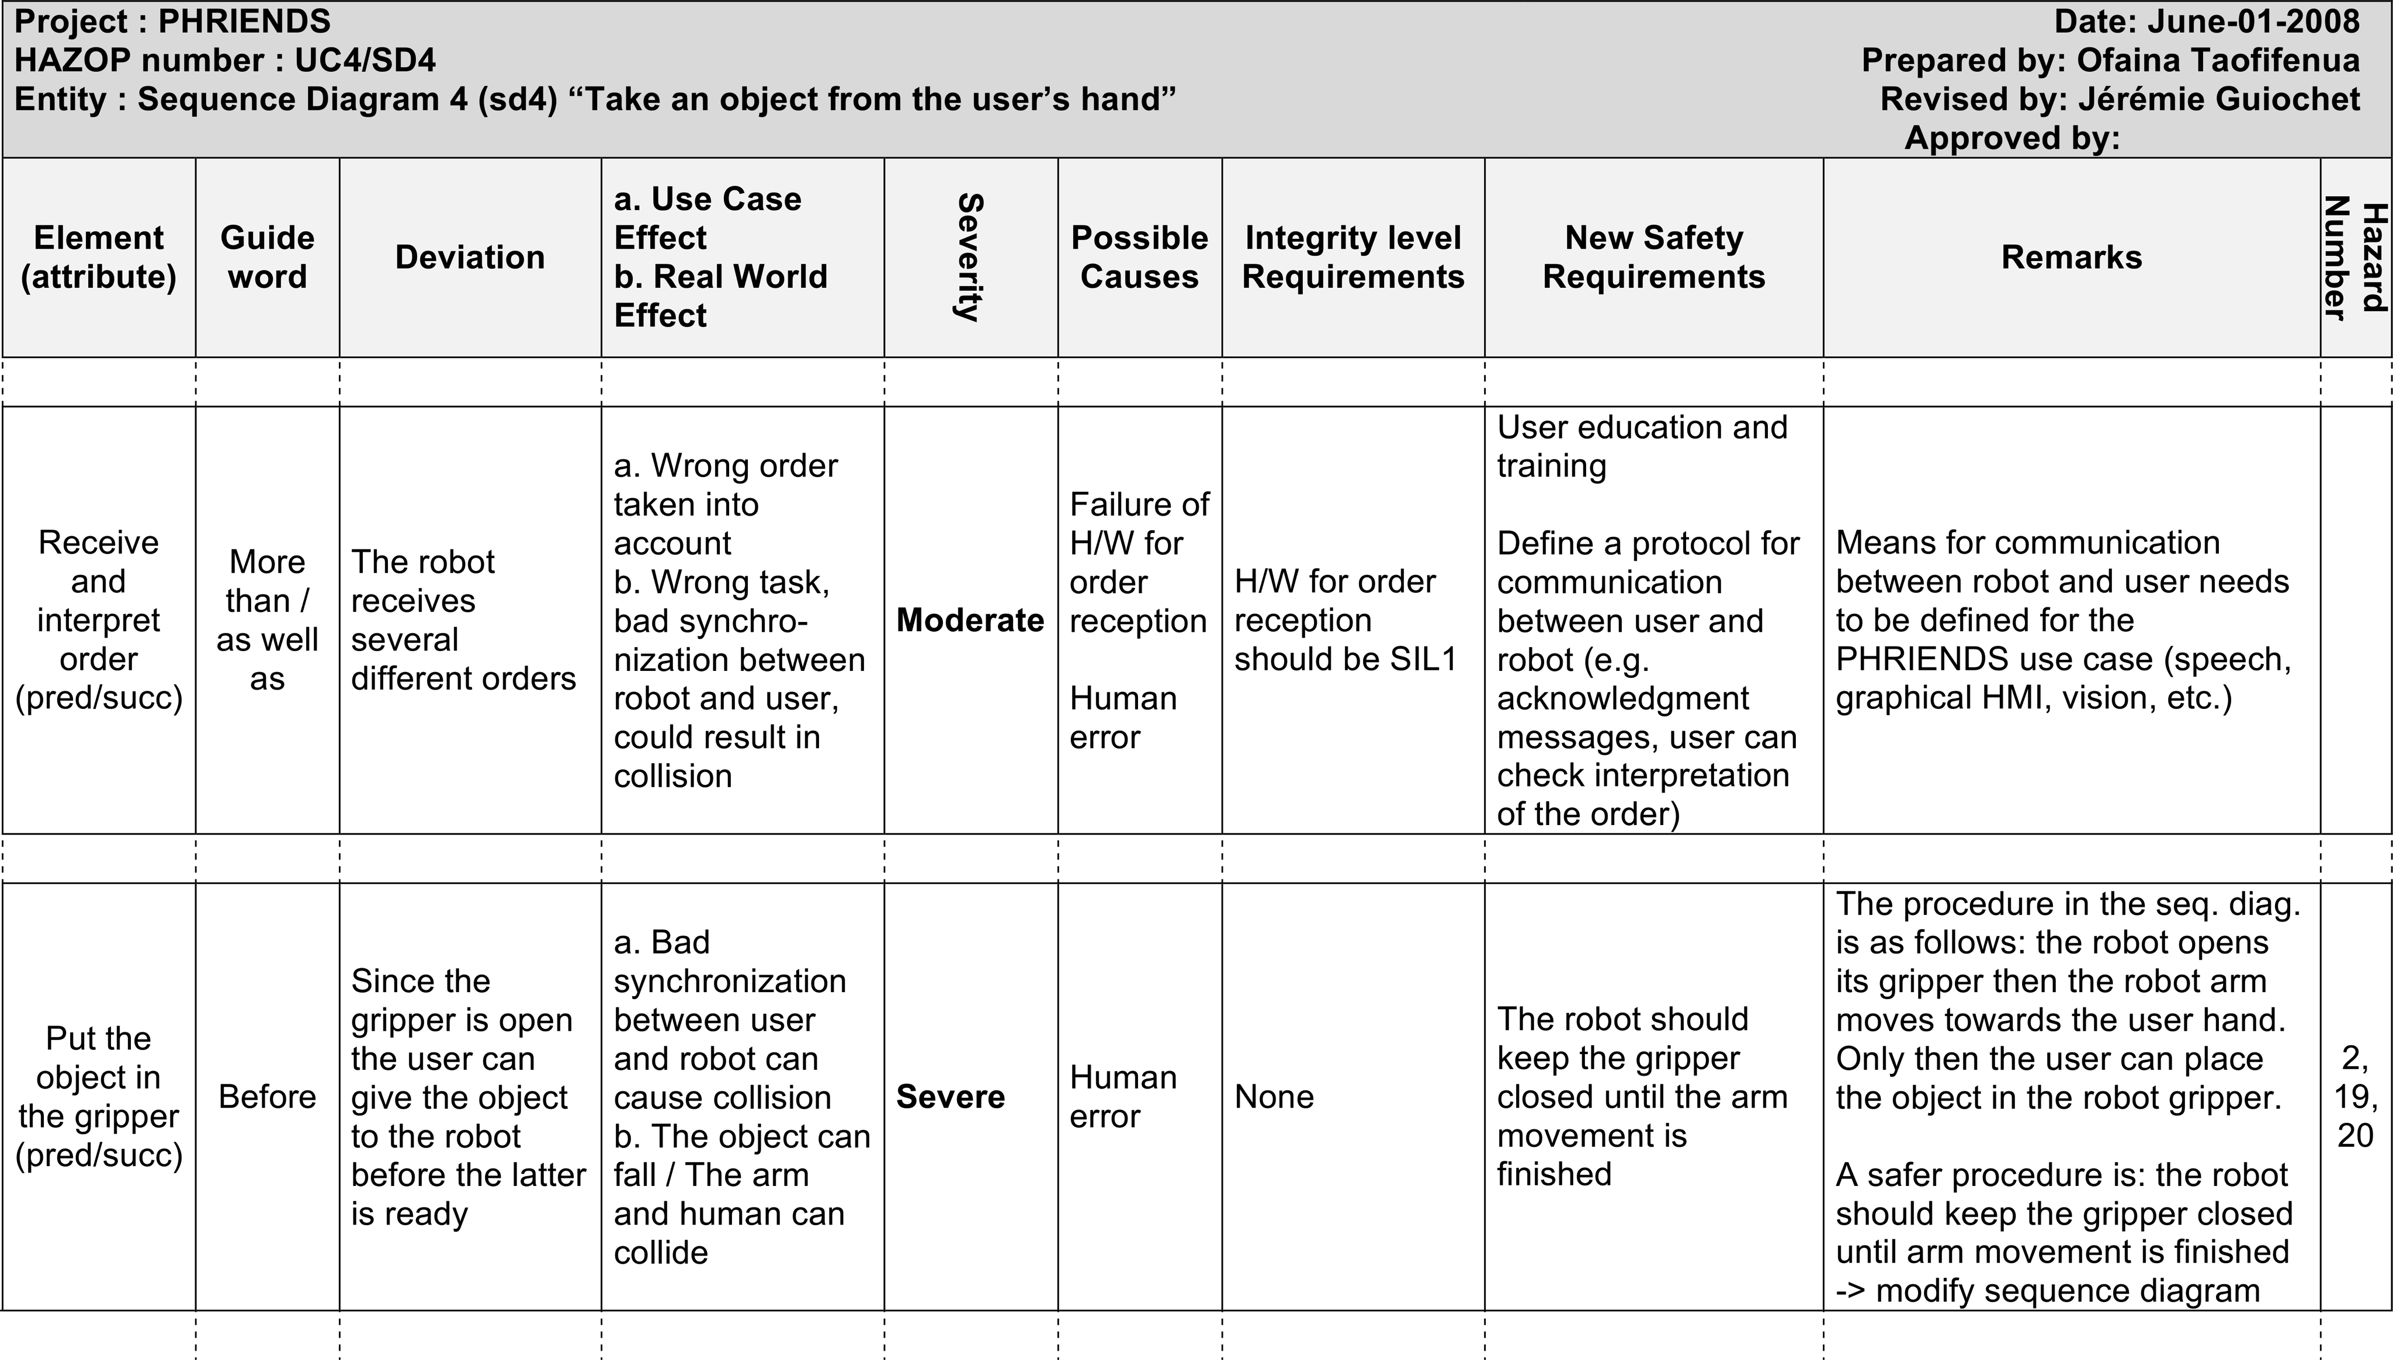
HAZOP-UML
HAZOP-UML
UML diagrams
Deviation analysis
HAZOP guidewords
Use case diagrams
Sequence diagrams
Table HAZOP-UML
Generic list
Hazards
Recommendations
State diagrams

Slide 4
Deviation analysis
UML
Guidewords for UML models
HAZOP Table

Slide 5
UML metamodel

Slide 6
Message guidewords

Slide 7
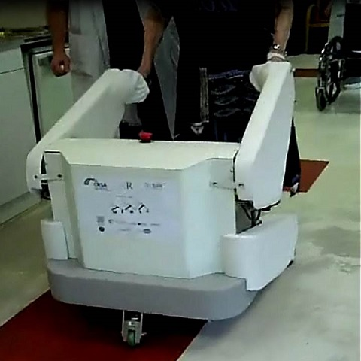

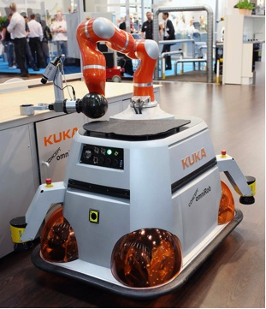

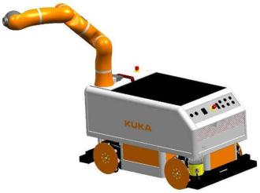
Previous applications
ANR-MIRAS (2009-2013) Multimodal Interactive Robot of Assistance in Strolling
FP6-PHRIENDS (2006-2009) : Physical Human-Robot Interaction: depENDability and Safety.
FP7-SAPHARI (2011-2015) Safe and Autonomous Physical Human-Aware Robot Interaction.

Slide 8
HAZOP-UML Complexity measures

Slide 9
HAZOP-UML -ity
Applicability: model based systematic analysis / few ressources / controlled complexity
Validity: has been compared to classic Preliminary Hazard Analysis
Usability: Simple / first step of the dev. Process / share models with system developers
Transferability: no specific tool / already transferred to several indus & research partners

Slide 10
Questions

Slide 11
CPSELabs application – 1st exp
With STERELA
HAZOP-UML Engineers training
HAZOP-UML @Application support
Input : Spec & UML models
Outputs : Hazards , safety invariants, recommendations

