Slide 1
HAZOP-UML in action

Slide 2
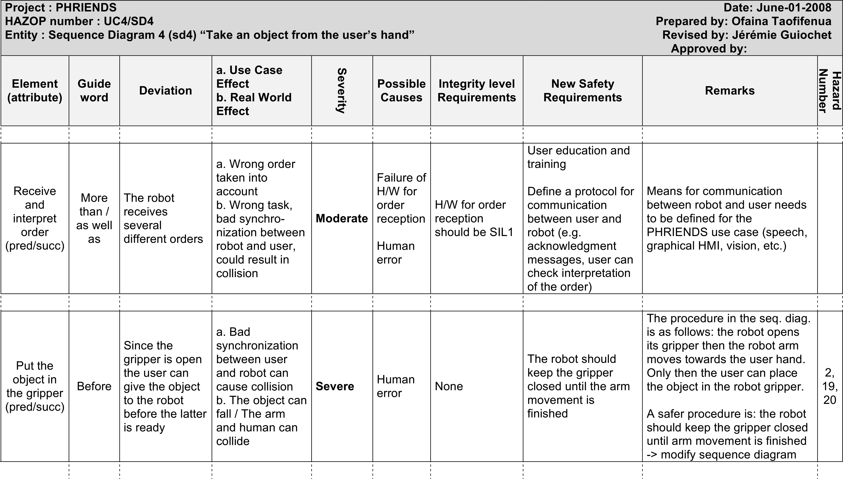
HAZOP-UML
HAZOP-UML
UML diagrams
HAZOP guidewords
Deviation analysis
Use case diagrams
Sequence diagrams
HAZOP-UML tables
Hazards
Recommendations
State diagrams

Slide 3
HAZOP-UML Process
UML models
  Actors & use cases identification, pre/post conditions and invariant identification for each use case
  Sequence diagram (nominal & alternative) for each use case
Deviation analysis for each element and for each attribute of UML diagrams (UC conditions & messages)

Slide 4
Exemple: rehabilitation robot

Slide 5
Use case specification

Slide 6
Sequence diagram
Sequence diagram specification
6

Slide 7
Sequence diagram

Slide 8
UML final models
Use case textual specification
For each use case one or more sequence diagram

Slide 9
Deviation analysis
UML
Guidewords for UML models
HAZOP Table

Slide 10
HAZOP-UML outputs

Slide 11
HAZOP-UML outputs, tracability
HAZOP-UML Tables
Hazards list
Recommandations list
Notes:
----- Notes de la réunion (13/03/15 19:36) -----
qui permet une traçabilité.
----- Notes de la réunion (16/03/15 11:51) -----
faire apparaître des tables
raccourcir les tables
on présentera les résultats ultérieurement lors de la présentation du cas d'étude

Slide 12
CPSELabs application – 1st exp
Sterela case study

